Slide 1
PROJECT 2
GROUP MEMBERS :
GURPREET KAUR
LAKSHMI PRIYANKA ANNAPUREDDY

Slide 2
OBJECTIVE
Designing a web application which processes data from spotify.com.
API DOCUMENTATION : API calls | Spotify for Developers
CODEBASE :
HTML
CSS
JAVASCRIPT

Slide 3
ENDPOINTS USED
Get New releases
Get several Albums
Get several Shows
Get several Artists
Search
Create playlist
Add tracks to playlists
Get the playlists
Get Profile
Get Recommendations

Slide 4
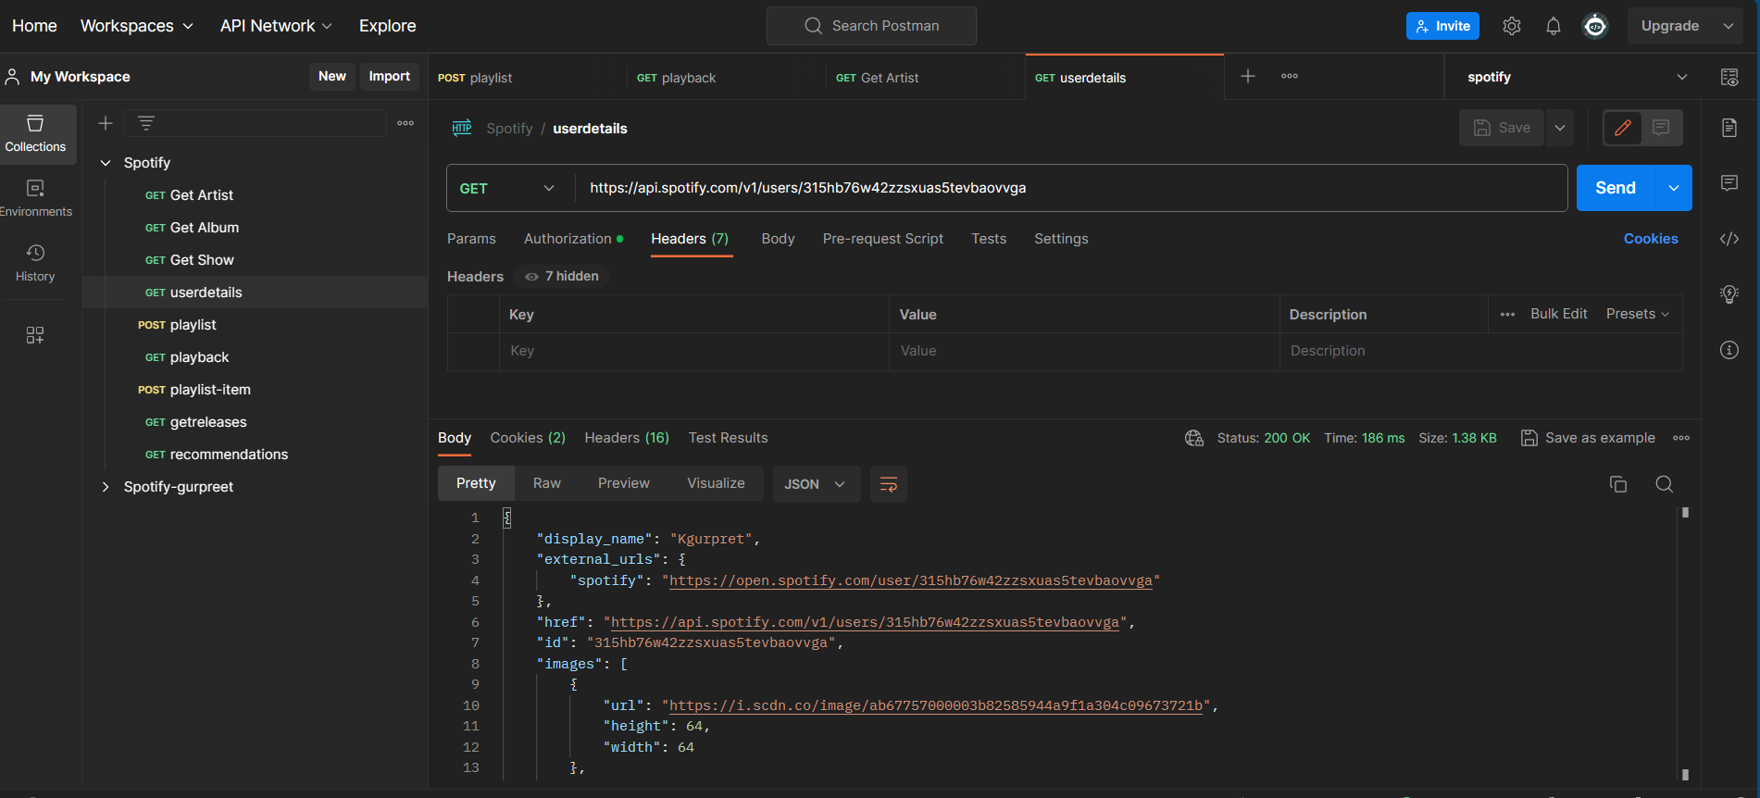
POSTMAN TESTING
Get Profile

Slide 5
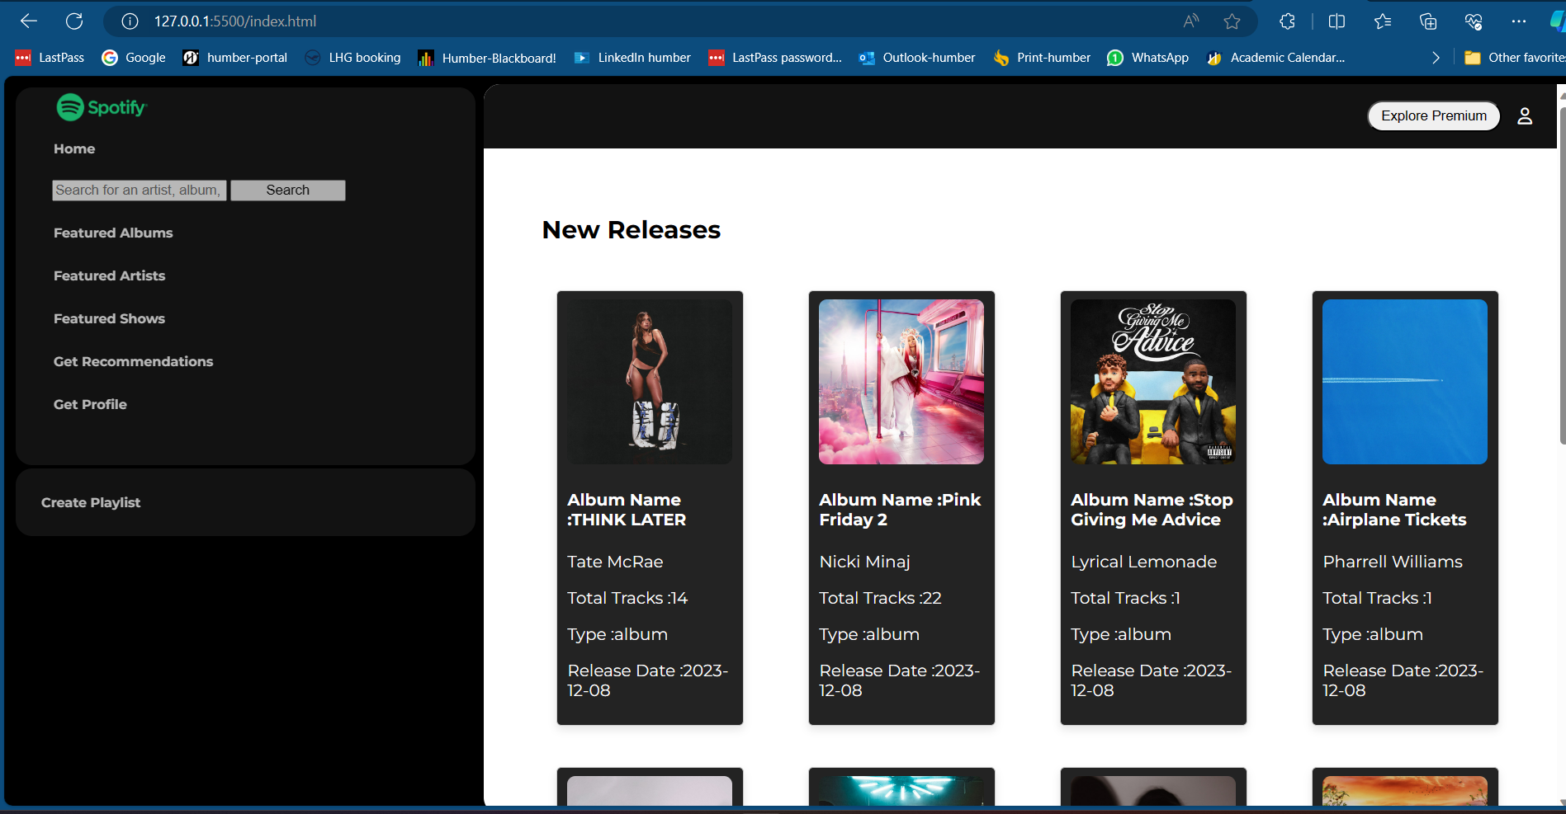
DESIGN
HOME PAGE

Slide 6
CHALLENGES
Issues to due to lack of premium account of spotify for certain API.
Introducing sleep to certain API calls.

Slide 7
THANK YOU

